Slide 1
Framework for
Professional Learning
School Board Presentation
December 6, 2018

Slide 2
Alignment to our Vision and Mission
Vision--All learners believe in their power to embrace learning, to excel, and to own their future.
Mission--The core purpose of Albemarle County Public Schools is to establish a community of learners and learning, through relationships, relevance and rigor, one student at a time.

Slide 3
Alignment to our Strategic Priorities
Create a culture of high expectations for all.
Identify and remove practices that perpetuate the achievement gap.
Ensure that students identify and develop personal interests.

Slide 4
Framework for Professional Learning in ACPS
Vestibulum congue
Personal Choice
and Interest Based
Teacher Growth for Student Learning
Strategic Priorities Based
Vestibulum congue
Vestibulum congue
Site Based
Division Based
Vestibulum congue

Slide 5
We believe Professional Learning should...
be purposeful for teachers and impactful for students
be personalized and differentiated
be relevant to current needs to prepare students for their futures
range from foundational to innovative
occur through a variety of means
be aligned to School Board vision, mission, goal, and priorities

Slide 6
Personal Choice and Interest Based
Vestibulum congue
Personal Choice
and Interest Based
It is all about owning the learning. When teachers identify and address what they need and want to learn and the school supports them by providing resources, people, and time, then that’s personal professional learning.
Barbara Bray
Rethinking Learning
Teacher Growth for Student Learning
Strategic Priorities Based
Vestibulum congue
Vestibulum congue
Site Based
Division Based
Vestibulum congue

Slide 7
Personal Choice and Interest Based
Vestibulum congue
Personal Choice
and Interest Based
Recertification - VDOE Requirements
PDRP & Opportunities Courses
Working with an Instructional Coach or LTI
Teacher Leadership Development
ALCP Roles
CRT Certification
Career Pathways -
Instructional Coaching
and Learning Technology Integrators
Internships
Teacher Leadership Academy
National Board Certification
Teacher Growth for Student Learning
Strategic Priorities Based
Vestibulum congue
Vestibulum congue
Site Based
Division Based
Vestibulum congue
Notes:
PDRP Process - 65 courses supported this first semester cycle
Opps Last Spring = 429 teachers
Opps this fall = 667 teachers

Slide 8
Site Based
Vestibulum congue
Personal Choice
and Interest Based
When learning is part of the school day, all educators are engaged in growth rather than learning being limited to those who volunteer to participate on their own. School-based professional development helps educators analyze student achievement data during the school year to immediately identify learning problems, develop solutions, and promptly apply those solutions to address students’ needs.
Learning Forward
Teacher Growth for Student Learning
Strategic Priorities Based
Vestibulum congue
Vestibulum congue
Site Based
Division Based
Vestibulum congue
Notes:
Quote from learning forward

Slide 9
Site Based
Vestibulum congue
Personal Choice
and Interest Based
Professional Learning Communities
School-Based Professional Development Days
Common Texts/Book Study
School Improvement Plans
Teacher Growth for Student Learning
Strategic Priorities Based
Vestibulum congue
Vestibulum congue
Site Based
Division Based
Vestibulum congue

Slide 10
Division Based
Vestibulum congue
Personal Choice
and Interest Based
Collective work in trusting environments provides a basis for inquiry and reflection into teachers’ practice, allowing teachers to take risks, solve problems, and attend to dilemmas in the practice.
Linda Darling-Hammond
Teacher Growth for Student Learning
Strategic Priorities Based
Vestibulum congue
Vestibulum congue
Site Based
Division Based
Vestibulum congue

Slide 11
Division Based
Vestibulum congue
Personal Choice
and Interest Based
Making Connections
Cultural Awareness /Competency (12)
Differentiation (12)
Social-Emotional Learning (6)
P-Based Learning (8)
Targeted Instruction (4)
Summer PD
Digital Learning
P-Based Learning
Instructional Strategies
CRT
Responsive Classroom and Developmental Designs
New Teacher Induction and New Teacher Academy
Instructional Coaching
Teacher Growth for Student Learning
Strategic Priorities Based
Vestibulum congue
Vestibulum congue
Site Based
Division Based
Vestibulum congue
Notes:
Oppo

Slide 12
Strategic Priorities Based
Vestibulum congue
Personal Choice
and Interest Based
The best professional development is ongoing, experiential, collaborative, and connected to and derived from working with students and understanding their culture.
Edutopia
Teacher Growth for Student Learning
Strategic Priorities Based
Vestibulum congue
Vestibulum congue
Site Based
Division Based
Vestibulum congue

Slide 13
Strategic Priorities Based
Vestibulum congue
Personal Choice
and Interest Based
CAI
P-based Learning
Teaching Hard History
Cornerstone Conferences
Freshman Seminar
SEAD Credentialing
CRT Micro-credentialing and Certification
Teacher Growth for Student Learning
Strategic Priorities Based
Vestibulum congue
Vestibulum congue
Site Based
Division Based
Vestibulum congue

Slide 14
SEAD Credentialing:
An Example of a
Strategic Priorities Based Initiative
Personal Choice
and Interest Based
Teacher Growth for Student Learning
Strategic Priorities Based
Site Based
Division Based

Slide 15
SEAD Credentialing
Four Strands:
School Culture and Responsive Classrooms
Culturally Responsive Teaching
Safe Brain and Trauma Sensitivity
Family Engagement
Key Components:
Offers Breadth and Depth of Professional Learning
Teachers have elements of choice
Self-paced
Integrates reflection and implementation into professional learning

Slide 16
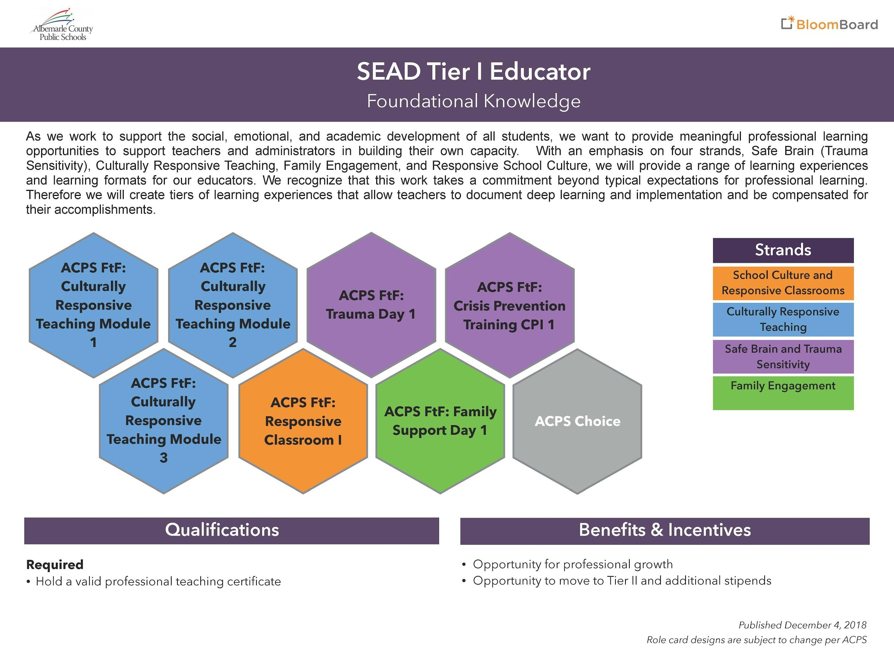

Slide 17
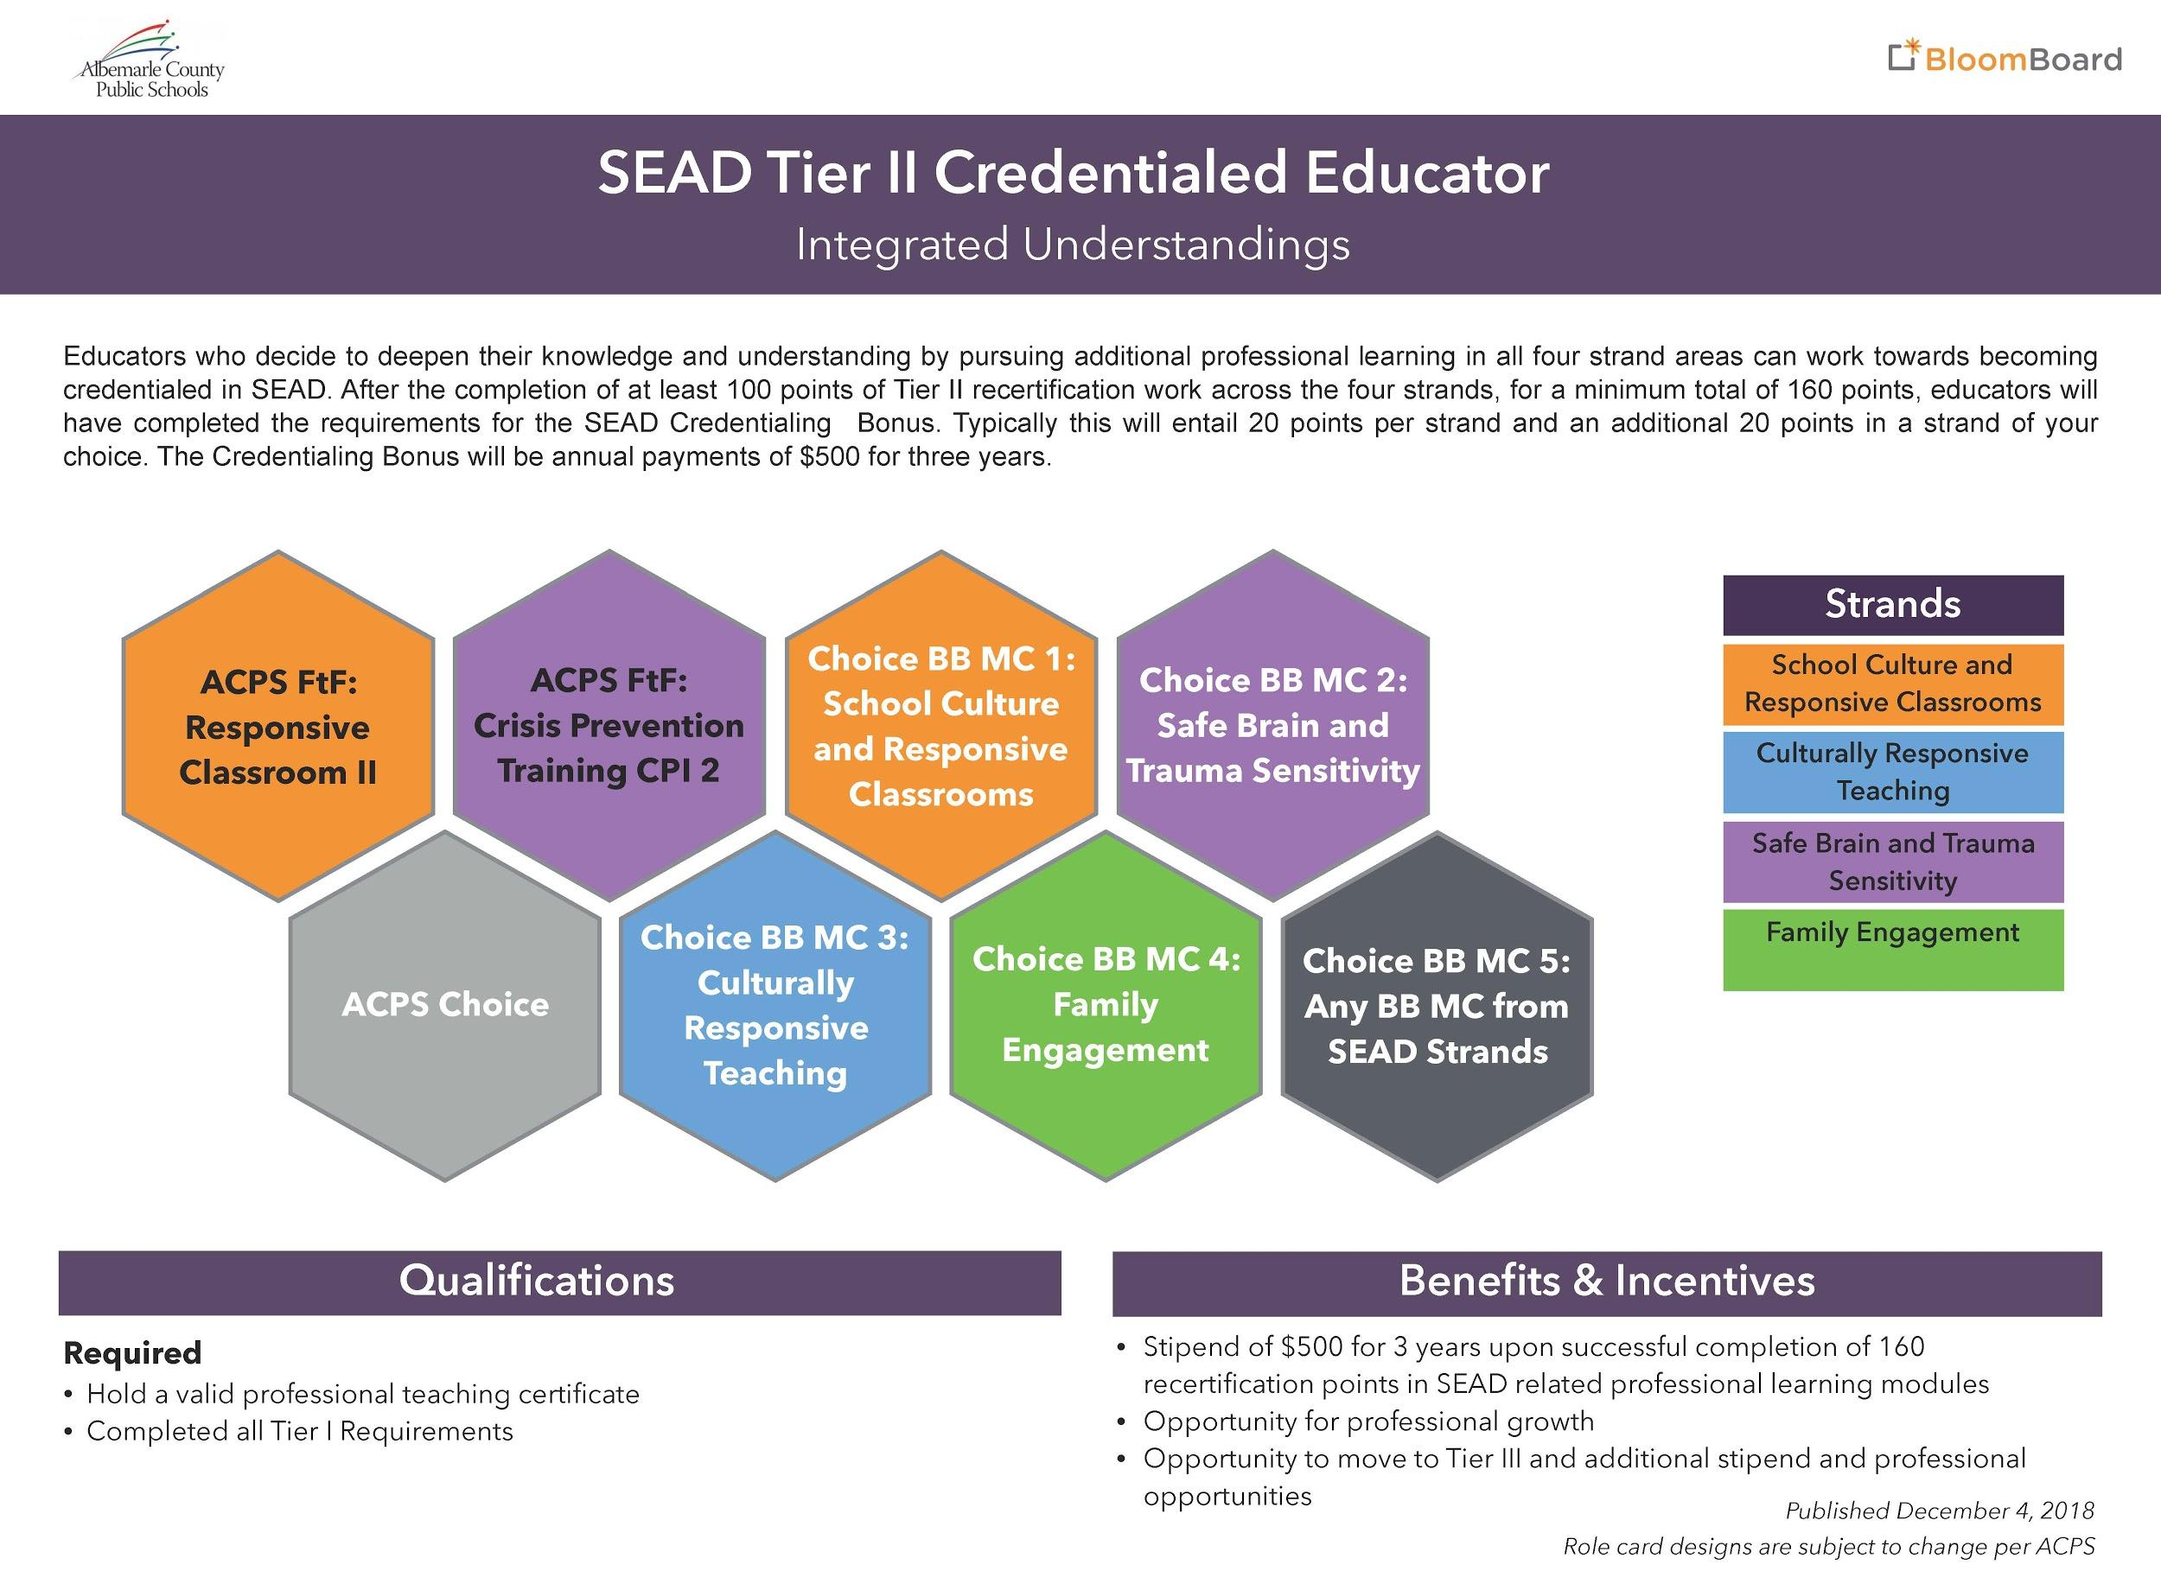

Slide 18
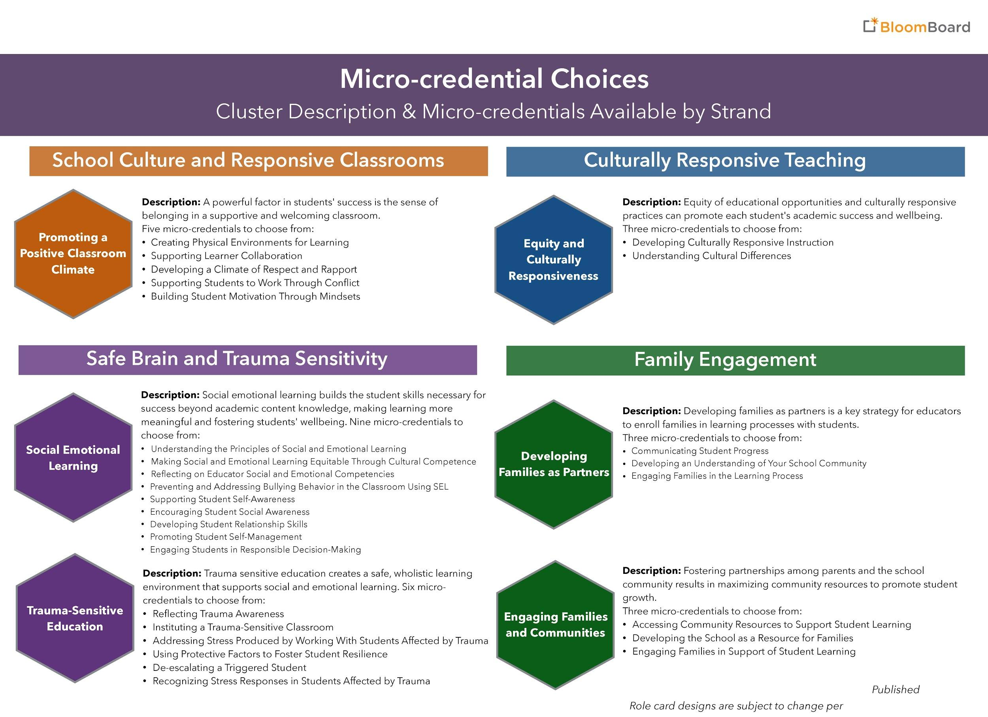

Slide 19
